Slide 1
(SIP) ASBU BO-FICE - AIDC Implementation Seminar (Bangkok, Thailand, 28- 31 October 2014)
Raza Gulam
Regional Officer, CNS
ICAO MID Regional Office, Cairo
ASBU B0 FICE AIDC Seminar 28- 31 October 2014

Slide 2
Aviation System Block Upgrades Module B0-FICE/PIA-2 Increased Interoperability, Efficiency and Capacity through Ground-Ground Integration

Slide 3
Encompasses Performance Framework
GANP History
Addresses ANSP, Regulatory and User requirements
Includes ASBU Methodology
Doc 9750
Global Air Navigation Capacity and Efficiecy Plan, Edition 4
2014-16
Doc 9750
Edition 3, 2006
Doc 9750
Edition 2, 2001
Doc 9750
Edition 1, 1998
Doc 9883, 2008
Global Performance Manual
Doc 9882, 2008
ATM System Requirements
Appendix to FANS Report, 1992
Doc 9854, 2005
Global ATM Operational Concept
Related documents

Slide 4
GANP- Contents (DOC 9750)
Strategic Objective: Capacity and Efficiency
EXCUTIVE VIEW
Chapter 1: Global Air Navigation Policy
Chapter 2: Implementation-Turning ideas into action Chapter 3: Near Term Standardization – Block 1
Chapter 4. Continuing Research – Blocks 2 and 3
Chapter 5: Aviation System Performance management
Appendices:
1. Fourth edition GANP: Evolution and Governance
2. Hyperlinked Online Support Documentation
3. Technology Roadmaps
4. Module Dependencies
5. SARPs Development Planning
6. Acronym Glossary
GANP
(Global Air Navigation Capacity and Efficiency Plan)
Notes:
Click link and go to GANP page 56

Slide 5
Global Priorities
AIR NAVIGATION
Performance-based Navigation
Air Traffic Flow Management
Aeronautical Information Management
Ground-Ground Digital Coordination/Transfer (coming soon)
ASBU Environmental Benefits (coming soon)

Slide 6
Module N° B0-FICE Increased Interoperability, Efficiency and Capacity through Ground-Ground Integration
Summary | To improve coordination between ATS Units by using AIDC. The transfer of communication in a data link environment improves the efficiency of this process particularly for Oceanic ATSUs
Main Performance Impact | KPA-02 Capacity - KPA-04 Efficiency KPA-07 Global Interoperability - KPA-10 Safety
Operating Environment/Phases of Flight | All flight phases and all type of ATS units
Applicability Considerations | Applicable to min. 2 ACCs dealing with en-route and/or TMA airspace. Greater number of consecutive participating ACCs  increase the benefits.
Global Concept Component(s) | CM - Conflict management IM - Information Management
Global Plan Initiatives (GPI) | GPI-16 Decision Support Systems
Pre-Requisites | Link with B0-40 (TBO – DATALINK)
Global Readiness Checklist |  | Status
 | Standards Readiness | Ready
 | Avionics Availability | No requirement
 | Ground systems Availability | Ready
 | Procedures Available | Ready
 | Operations Approvals | Ready

Slide 7
Module N° B0-FICE - Baseline
Classical coordination by phone and procedural and/or radar distance separations
New Flight Plan 2012 and AMHS/IPS (not included in this module) but mapped to this module

Slide 8
Module N° B0-FICE – Change Brought by the Module
Implementation of the set of AIDC messages in the Flight Data Processing System (FDPS) of the different ATS units
Establishment of Letter of Agreement (LoA) to determine the appropriate parameters.
First step towards 4D trajectory exchanges between both G/G & A/G according to the ICAO Operational Concept (Doc 9854).
Notes:
The module makes available a set of messages to describe consistent transfer conditions
via electronic means across ATS units’ boundaries. It consists of the implementation of the set of AIDC
messages in the flight data processing systems (FDPS) of the different ATS units involved and the
establishment of a Letter of Agreement (LoA) between these units to set the appropriate parameters

Slide 9
Module B0-FICE – Intended performance Operational Improvement
Capacity | Reduced controller workload Increased data integrity supporting Reduced separations translating directly to cross sector or boundary capacity flow increases.
Efficiency | - Reduced separation can be offered more frequently to aircraft flight levels closer to the flight optimum; in certain cases, this also translates in reduced en-route holding.
Global Interoperability | Seamlessness: the use of standardised interfaces reduces the cost of development, allows controller to apply the same procedures at the boundaries of all participating centres and border crossing becomes more transparent to flights.
Safety | Better knowledge of more accurate flight plan information
CBA | Increase of throughput at ATC unit boundary, reduced ATCO Workload will exceed FDPS software changes cost.

Slide 10
Module N° B0-FICE – Necessary Procedures (Air & Ground)
Required procedures exist
Experience from other regions can be a useful reference
Notes:
Required procedures exist. They need local analysis of the specific flows and should be
spelled out in a Letter of Agreement between ATS units; the experience from other regions can be a
useful reference.

Slide 11
Module B0-FICE – Necessary System Capability
Avionics
No specific airborne requirements
Ground Systems
A set of AIDC / OLDI messages in Flight Data Processing and could use the ground network standard AFTN-AMHS or ATN.
Europe is presently implementing IP Wide Area Networks
It also includes for oceanic ATSUs a function supporting transfer of communication via data link.

Slide 12
Module B0-FICE – Training and Qualification Requirements
Training for the automation support will be required.
Training in the operational standards and procedures are also required.
Likewise, the qualifications requirements are identified in the regulatory requirements in Section 6 which form an integral part to the implementation of this module.

Slide 13
Module N° B0-FICE – Regulatory/Standardization needs and Approval Plan (Air & Ground)
Regulatory/Standardization: Use current published criteria that include:
ICAO Doc 4444, Procedures for Air Navigation Services — Air Traffic Management;
EU Regulation, EC No 552/2004.
Approval Plans: Regional Plans “Developed” for MID during AIDC/OLDI Seminar Mar 2014 forms regional agreement

Slide 14
Module B0- FICE – Reference Documents
Standards
• ICAO Doc 4444, Procedures for Air Navigation Services - Air Traffic Management, Appendix 6 - ATS Interfacility Data Communications (AIDC) Messages
• ICAO Doc 9880, Manual on Detailed Technical Specifications for the Aeronautical Telecommunication Network (ATN) using ISO/OSI Standards and Protocols, Part II — Ground-Ground Applications — Air Traffic Services Message Handling Services (ATSMHS).
Procedures: To be determined.
Guidance Material
• ICAO Doc 9694, Manual of Air Traffic Services Data Link Applications; part 6
• GOLD Global Operational Data Link Document (APANPIRG, NAT SPG), June 2010;
• Pan Regional Interface Control Document for Oceanic ATS Interfacility Data Communications (PAN ICD) Coordination Draft Version 0.3. 31 August 2010;
• Asia/Pacific Regional Interface Control Document (ICD) For ATS Interfacility Data Communications (AIDC). ICAO Asia/Pacific Regional Office. http://www.bangkok.icao.int/edocs/icd_aidc_ver3.pdf
• EUROCONTROL Standard for On-Line Data Interchange (OLDI); and EUROCONTROL Standard for ATS Data Exchange Presentation (ADEXP)
New documents developed for APAC and NAT (PAN Regional ICD for AIDC )

Slide 15
Global Dash Board Monitoring

Slide 16
Conclusion
Global Plan
Regional Plan
Is there benefit
Are there guidance
What is next

Slide 17
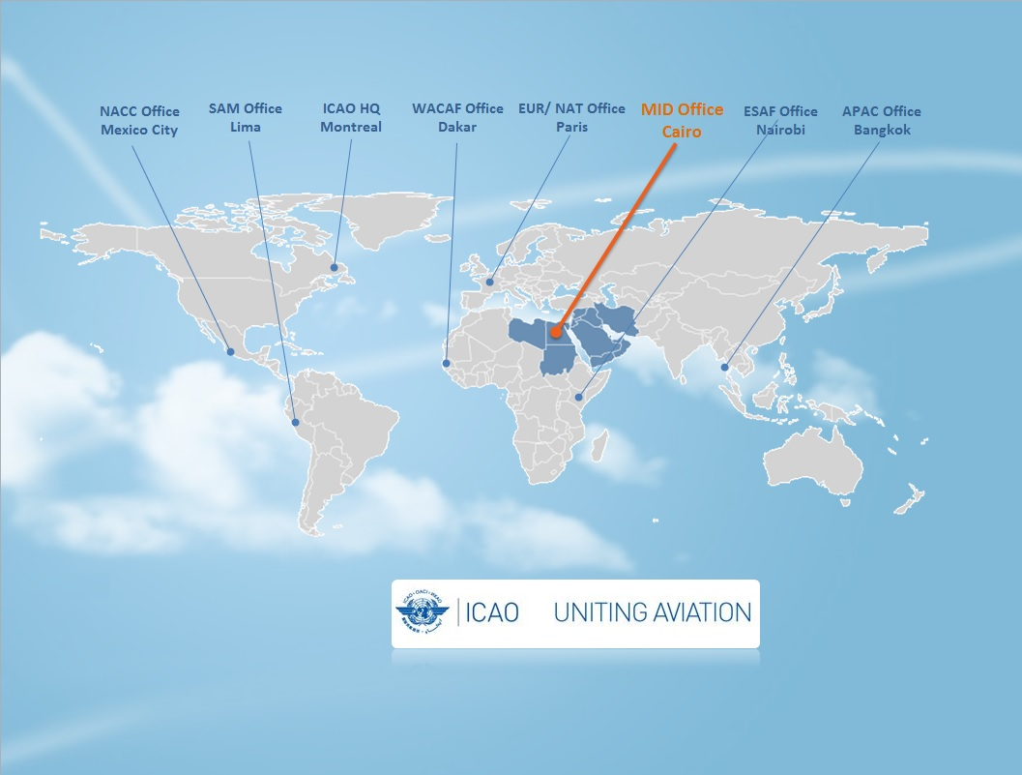
ขอขอบคุณ
شكرا
Thank You

